Slide 1



Contributions à la Gestion de l'Hétérogénéité dans les Environnements Distribués et Pervasifs
Luiz Angelo STEFFENEL
Habilitation à Diriger des Recherches
Soutenance publique
Reims, 8 décembre 2017

Slide 2
What is a Distributed System?
Most definitions consider at least these properties
Independent elements, loosely coupled (nodes, machines)
Coordination is made by message exchange
Resources state and capabilities may vary over time
Heterogeneity

Slide 3
What is Heterogeneity?
Noun - the quality or state of consisting of dissimilar or diverse elements
There is not only one kind of heterogeneity
Diversity in a group
Diversity of groups
Dealing with heterogeneity can be compared to a puzzle-solving problem

Slide 4
Heterogeneity in Distributed Systems
Different views and classifications can be used, for example:
Material heterogeneity
Communication heterogeneity
Task heterogeneity
Data access heterogeneity
Variations through time
The complexity tends to augment as the systems grow

Slide 5
Towards Pervasive Computing
Cloud, Mobile computing and IoT induce even more heterogeneity
Distant resources that are "somewhere" in the cloud
Mobile devices that move through the networks
Material diversity and capacity constraints

Slide 6
My Motivation
To investigate and to develop (elegant) solutions for problems caused by heterogeneity
Sub-optimal performances
Lack of adaption, lack of context-awareness
Uncertainty about the resources (volatility, discovery, etc.)
Bad scheduling or placement of tasks and services

Slide 7
Contributions to Heterogeneity Management
Applications
Modeling and optimizing communication heterogeneity for grids
Dealing with task heterogeneity when parallelizing a biology application
Context-awareness techniques for resources dynamicity
Middleware development experiences
Middlewares
Networks
Devices

Slide 8
Communication Heterogeneity
Modeling and Optimizing Collective Communications
Contributions à la Gestion de l’Heterogeneité dans les Environnements Distribués et Pervasifs

Slide 9
Modeling communications
Communication heterogeneity impacts the coordination of nodes
In local networks we can approximate these costs
Just need a good model and good parameters
For example, the Broadcast (one-to-many) communication pattern

Slide 10
Broadcasts in grids
In a grid, we have different network performances
Between clusters
Inside clusters
One single model cannot represent all variations
For simplicity, we can structure in 2 levels
Internal – chose the best algorithm from a set of existing models/implementations
Inter-cluster – specially tailored broadcast tree that interconnects "cluster heads"

Slide 11
Broadcasts in grids - heuristics
We need to construct an ad-hoc broadcast tree
Select the "next cluster head" according to different optimization rules
Faster nodes
Minimize intra-cluster comm
Maximize source nodes
...

Slide 12
What about All-to-All?
All-to-All is a more complex pattern
n(n-1) different data to send through the network
2n messages over the inter-cluster link (slow)
Highly impacted by network contention
Why not regroup all msgs for a destination before sending them?
LG algorithm
Defines "corresponding" peers
Minimizes contention

Slide 13
Task Heterogeneity
Parallelizing a bioinformatics application
Contributions à la Gestion de l’Heterogeneité dans les Environnements Distribués et Pervasifs

Slide 14
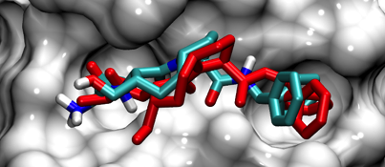
Motivation
Subject of a PhD thesis in Bioinformatics
Romain Vasseur – Inverse Docking
Used in drugs research by the pharmaceutic industry
In this case, the "reference" application is a "monolithic" simulator
We seek to explore databases with hundreds of proteins
One protein-peptide docking exploration may take hours
How to parallelize it without touching the simulator code?

Slide 15
Parallelizing the Molecular Docking
Solution: divide the data... But how?
Geometric decomposition
With superposition
Development of AMIDE, a framework for data decomposition and task scheduling
Workflow for generating subgrids and deploying tasks
Can be used both in an ad-hoc environment or through a resource manager (like Slurm)

Slide 16
Context Adaption
Improving Apache Hadoop
Contributions à la Gestion de l’Heterogeneité dans les Environnements Distribués et Pervasifs

Slide 17
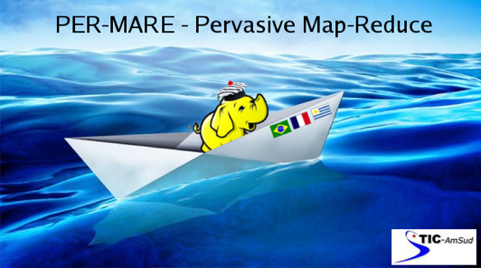
Improving Apache Hadoop
Hadoop was designed to operate in clusters
Static and stable configuration (XML files)
Does not react to changes in the resources capabilities
There is no "live" adaption
Project PER-MARE aimed at deploying Hadoop over pervasive networks
Heterogeneous nodes (SoC, desktop grids, etc.)
Volatile nodes
We need context information

Slide 18
Acquiring and Injecting Context Information
The ResourceManager is the source of information for the schedulers
Its data comes from XML config files
We created a context collector that updates the information through Zookeeper

Slide 19
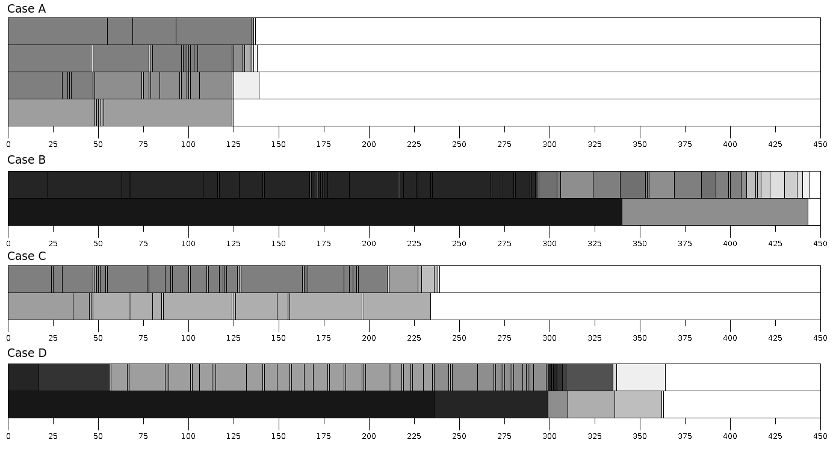
Impact of Context Change
4 nodes ok
2 nodes with the configuration of 4 nodes
2 nodes
Context updated from beginning
2 nodes
Context updated after the execution started

Slide 20
Middleware Development
Learning steps
Contributions à la Gestion de l’Heterogeneité dans les Environnements Distribués et Pervasifs

Slide 21
The Experience of GRAPP&S
Subject of a co-tutelle PhD
Originally aimed to extend CONFIIT
Tentative to specify an overlay for transparent data access
The work never advanced beyond the specification phase
Over time, other APIs filled the gap (Apache Jena, etc.)
Many possibilities that were never explored
Data relocation (like a "dynamic" Amazon Glacier)
Development and test of proxies
format identification standards (MIME, RDF, etc.)

Slide 22
The CloudFIT framework
PaaS computing framework based on P2P overlays
Designed for computing on pervasive environments (PER-MARE project)
Fault tolerance
Decentralized scheduling
DHT storage with replication
Modular and Extensible
Different P2P overlays
Context, scheduling, IoT
FIT API
How many tasks?
What a task must do?
Which data to access, which actions
Optional task dependency (DAGs)

Slide 23
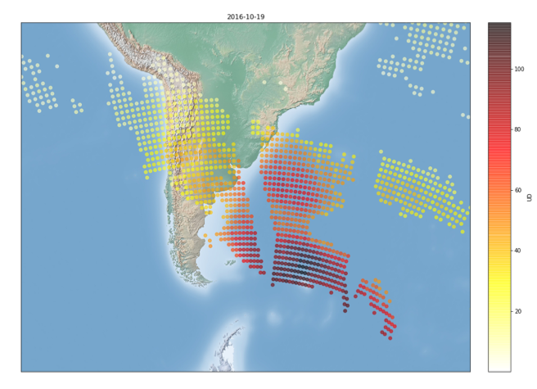
CloudFIT at work
Map-Reduce applications (benchmark against Hadoop)
Ozone Secondary Events (OSE) detection
Drastic reductions on the ozone column that may reach medium latitudes and cause high UV exposition to the population
Caused by air masses that detach from the polar vertex
We created an OSE detection workflow

Slide 24
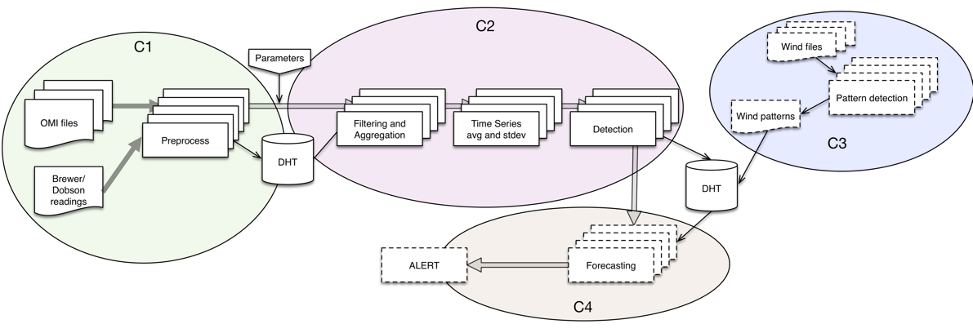
CloudFIT at work
Map-Reduce applications (benchmark against Hadoop)
Ozone Secondary Events (OSE) detection
Drastic reductions on the ozone column that may reach medium latitudes and cause high UV exposition to the population
Caused by air masses that detach from the polar vertex
We created an OSE detection workflow

Slide 25
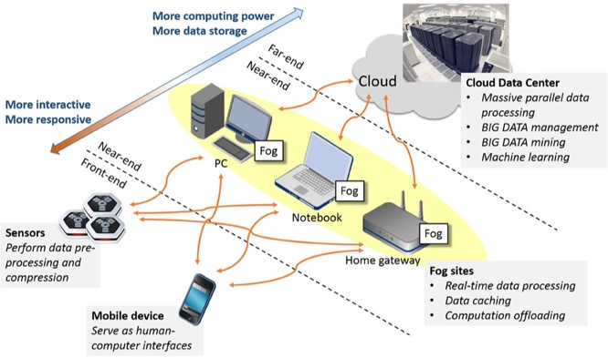
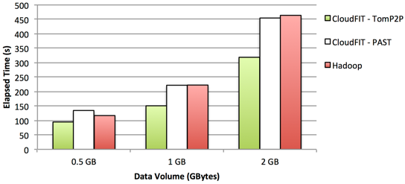
CloudFIT Perspectives
Focus on fog/edge computing
Development of multi-scale applications
Context-awareness and automatic clustering to help task placement
Data locality for big data applications
DHTs often spread data, losing locality
Access times may impact Big Data applications
Improve data locality through
Locality reinforcement (DHT trick)
Check if data is local (scheduling)

Slide 26
Conclusions and Perspectives
Contributions à la Gestion de l’Heterogeneité dans les Environnements Distribués et Pervasifs

Slide 27
Research Summary
Grenoble PhD
Nancy ATER
Reims MCF
2005
2006
2007
2008
2009
2010
2011
2012
2013
2014
2015
2016
2017
BCast
CONFIIT
CloudFIT
AlltoAll
GRAPP&S
Container Perf
Matrix Multiplication
Intentional PIS
Hadoop
WSN
Molecular Docking
Activities
Grenoble
Paris 13
Paris 1
Nancy
Nancy / Grenoble / Lyon
UFSM (Brazil)
ESSTT - Tunisia
UdelaR
UdelaR/UBA
Collaborations
Alshabani
Romain Vasseur
Guzman
Thierno Diallo
Advising
CAPSEC Rofica
MESO
ANR USS SIMGRID
PER-MARE
ANR?
CloudFIT
CC-SEM
Projects

Slide 28
Research Domains
Fog Computing and Pervasive environments
Context adaption, virtualization and microservices
Integration with SDN
Internet of Things and Smart Cities
Smart Agriculture
Energy consumption monitoring
Green IT
Distributed Computing and Big Data
Integration with fog computing applications and IoT
Exploration of new tools (Apache Storm, ...)
Data handling and analysis

Slide 29
Administration Responsibilities
Grenoble PhD
Nancy ATER
Reims MCF
2005
2006
2007
2008
2009
2010
2011
2012
2013
2014
2015
2016
2017
M2 ASR EAD
Lpro CMSII
M1 Computer Sciences
Pedagogical Responsibilities
Grid5000 board
CReSTIC board
Research Responsibilities
G5K SS
BigD2M Wshop
Journals guest editor
HCERES/AERES
Consulting and Chairing
PER-MARE
MESO
CloudFIT
CC-SEM
Project Management

Slide 30
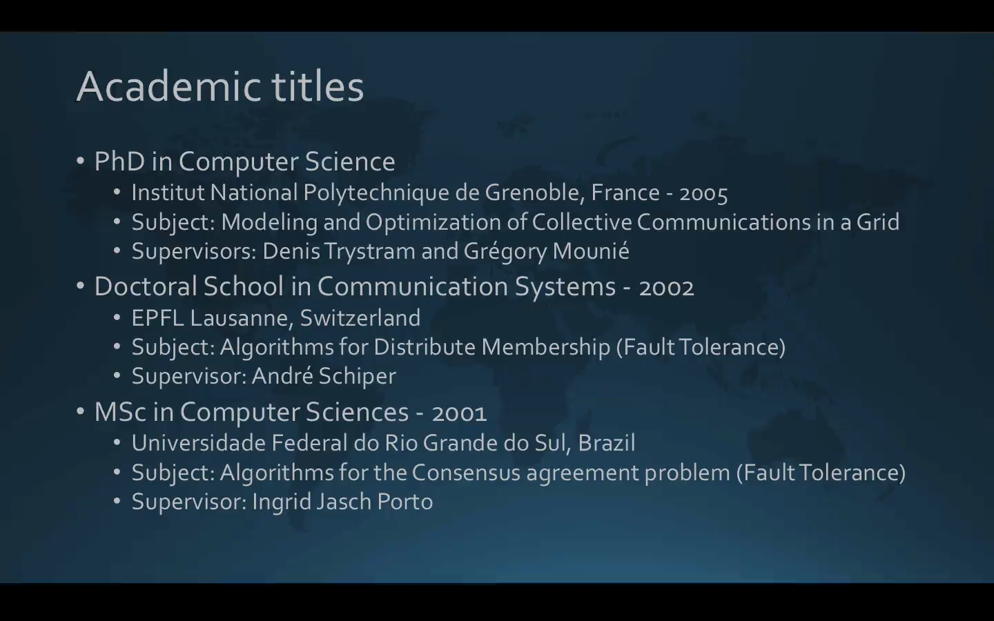
Thank you for your attention
Contributions à la Gestion de l’Hétérogénéité dans les Environnements Distribués et Pervasifs
Luiz Angelo Steffenel

Slide 32
Molecular Docking 101
Molecular docking is a simulation technique to identify good binding conformances between two molecules
In our case, protein-peptide
A "blind docking" consists in trying multiple arrangements and comparing the energy score
Good coverage need hundreds of tentatives
The data provided has two 3D grids:
The location (and energy) of each protein atom
The location (and energy) of each peptide atom

Slide 33
The Design of CloudFIT

